Slide 1
Water Storage in the Home
By The PrepLady, Becky Goodrich
Preplady.blogspot.com
utahpreplady@gmail.com

Slide 2
Why store water?
See http://www.webmd.com/diet/6-reasons-to-drink-water
Digestion: The digestive system uses a large amount of water. From preventing the over-absorption of sugars and chemicals to promoting metabolism and regular bowel movements, water is a central part of the entire digestive system.
Nervous system: Considering that the brain is mostly water, healthy water is the key to total body health as well as avoiding problems with the nervous system. Many headaches can be alleviated or lessened by drinking more water. Being dehydrated can also affect one’s focus.

Slide 3
Detoxification: The kidneys need pure, fresh water to detoxify the body. Clean water helps the kidneys rid the body of toxins and keeps your urinary system working well. Healthy water also reduces your risk of bladder infections, improving the immunity of your body.
“From a strictly survival perspective, water is the most important element for your body. A person can lose all reserve carbohydrate and fat and about half the body's protein without being in real danger. A loss of only 10-22% body weight as water is fatal. The amount of water lost from the body through urine, water vapor from the lungs, and perspiration averages 2.5 liters per day. Water loss must be made up by fluids consumed and by the water produced in the body as a result of metabolic processes. The effects of dehydration are dramatic: thirst, sleepiness, apathy, nausea, emotional instability, labored breathing, dizziness, delirium--and finally death. Infants, children, the elderly or physically ill persons are particularly susceptible to dehydration.” EPICCENTER.COM We can last about 3 days w/o water.

Slide 4
How can I conserve/save water? Think about:
How many times can you use the same water?
How little water can you use and still do the job?
Brush teeth with ¼ c water
Hand wash dishes and clothes
Sponge bath
http://wateruseitwisely.com/100-ways-to-conserve
See the FEMA website or my disaster book under the DROUGHT section.

Slide 5
How much water do I need?
https://www.redcross.org/images/MEDIA_CustomProductCatalog/m4440181_Food_and_Water-English.revised_7-09.pdf
Normal, active person needs at least ½ gallon drinking water daily FEMA/RC or quart of water with no activity DOD; 2 quarts/day to drink, 2 quarts for food prep/sanitation CDC
2-week supply of one gallon/person/day RC/DOD/Providentliving.org
Male needs 3.7L, female needs 2.7L daily, active adults in warm weather need 6+L Auerbach

Slide 6
Consider: pregnant, nursing, ill, hot weather, pets, barter ☺
Minimize the amount of water needed by reducing activity and staying cool.
Never ration water. Drink what you need today and find more later. RC/CDC
Genuine thirst develops only after dehydration is present. If fluid intake occurs after thirst and is less than fluid loss, the outcome is progressive dehydration. Auerbach
Physical symptoms only manifest when fluid losses are severe and debilitating; affect memory, decision making, vision, attention, mathematics. Auerbach
Loss of sodium can result in death; consumption of electrolyte supplemented drink should substantially delay or prevent this outcome. Auerbach

Slide 7
What’s needed for success? SIMPLE!
Clean container
Clean water
Clean hose

Slide 8
What containers should I use?
You will need:
Portable (short-term)
Stationary (long-term) water
Keep in mind that a gallon of water weighs 8 pounds.
Use only containers with screw on lids for the best seal.
Blue colored plastics block algae growth.

Slide 9
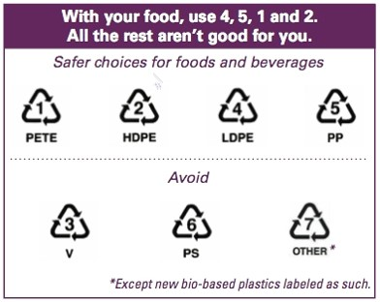
Good, Better and Best Containers for Water Storage

Slide 10
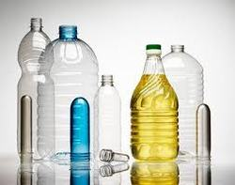
PET (polyethylene terephthalate), a clear, tough polymer with exceptional gas and moisture barrier properties.
There is some concern about leeching of plasticizers used in making PET bottles (stamped with PET on the bottom). FDA says doses are small and happen with prolonged use.
Some kinds get brittle and crack.
Water evaporates from it in the heat.
PET is ok; there is better; use it if it’s your only option

Slide 11
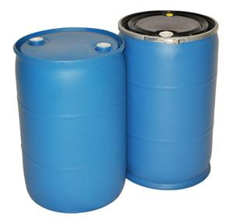
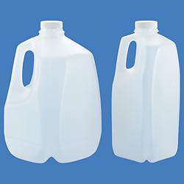
HDPE (high density polyethylene): FDA-approved food grade, used in milk, juice and water containers because of excellent protective barrier. Its chemical resistance properties also make it well suited for items such as containers for household chemicals and detergents. Must have “HDPE” stamped on it and coded with“2″ in a triangle.
Most five gallon food buckets are made from HDPE.
HDPE runs the gamut from milk jugs (which you should never use) to the blue 55 gallon barrel (the water storage staple), so ensure you understand the differences.

Slide 12
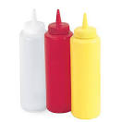
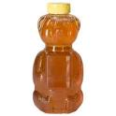
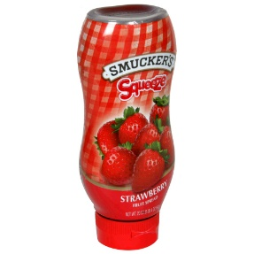
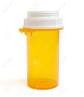
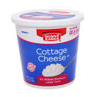
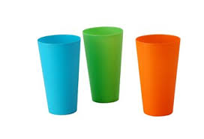
LDPE 4 and PP 5: food grade plastics that would be good for reuse if they applied to water.
PP 5: food grade plastics that would be good for reuse if they applied to water.
DO NOT USE Plastic 3, 6 and 7 or items stating BPA, DEHP, DEHA, PVC or PS.
(I couldn’t find any of these kinds of plastics around my home to verify their images.)

Slide 13
Any PET plastic container that previously held food or beverages such water, juice, punch, soda may be used. No cardboard juice or milk containers—leak, not long-term.
No milk jugs = milk protein = bacteria, get brittle CDC
No fruit juice jugs (like milk jugs) = bacteria growth.
No glass = too heavy, breaks.
Purchase commercially bottled water in non-jug containers, since jugs crack, leak and evaporate in my experience. Keep in original container. FEMA/RC
Don’t use containers previously used for non-food products ProvidentLiving.org or chemicals. CDC Bleach and soap bottles for hygiene only and label them as “non-drinking water.”

Slide 14
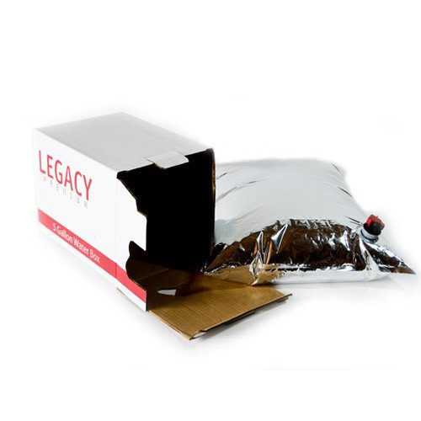
Mylar bags in a box. The 5-gallon metalized bag is filled with water and then placed in a cardboard box, kept from light, limiting any bacteria or algae growth, easy to stack and use vertical space LDSLiving.com
Mylar pouches contain @ 4 oz. of water
Multiple sizes for different emergencies.
Buy in 1-, 3- 5-, 55-, 160-, 320-gallon sizes with a spout
Oxfam bucket, jerry can/CDC jerry can, bucket w/lid and spout, clay pots CDC
5-gallon Mylar bag to fill with water and a box and toilet paper for sanitation.

Slide 15
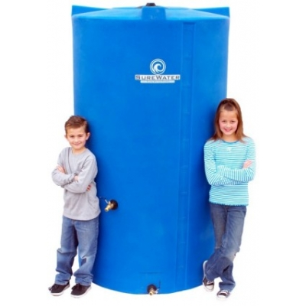
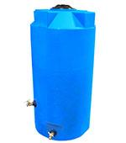
Stationary Containers
525 gallon barrel, $1,000 is a good price point, 525 days of water storage for one person, 4200 pounds, 45” D x 80” H. Must be something between it and concrete, on smooth, level surface. Excellent use of vertical space. One and Done!
250 gallon barrel, $325 is a good price point, 250 days of water storage for one person, 2000 pounds, 36” D x 67” H. Must be something between it and concrete, on smooth, level surface. Excellent use of vertical space. One and Done!

Slide 16
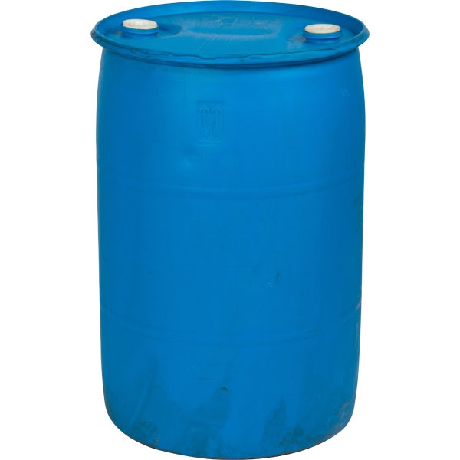
Stationary Containers
55 gallon barrel, $40 is the best price point, 55 days of water storage for one person, 440 pounds. Must be kept off concrete, on smooth, level surface. Make sure to get the bung wrench, spigot and Super Jiggler hose ($7) to get the water out later.
30 gallon barrel, $40 is the usual price point, 30 days of water storage for one person, 240 pounds. Harder to find. Would only use due to space issues. Must be kept off concrete, on smooth, level surface. Make sure to get the bung wrench, spigot and Super Jiggler hose ($7).

Slide 17
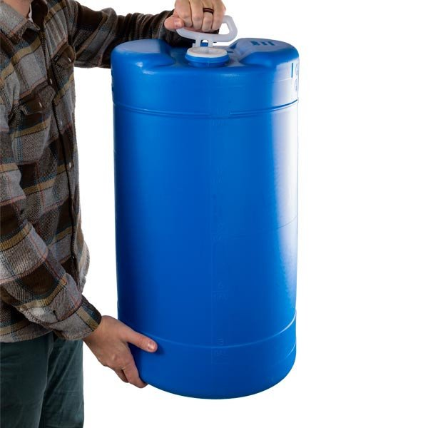
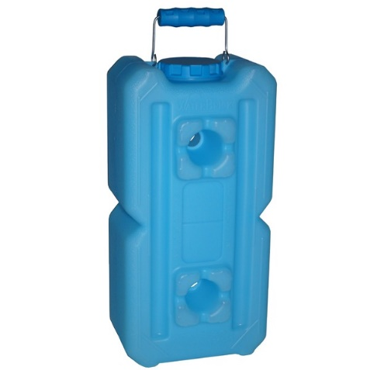
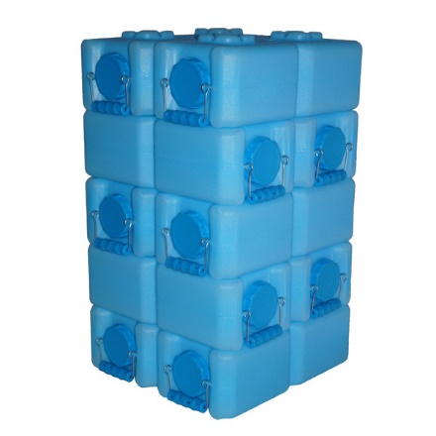
Portable Containers
15 gallon barrel, $41 is the best price point, 15 days of water storage for one person, 120 pounds. Must be kept off concrete, on smooth, level surface OR can be laid on side like wine barrel. Make sure to get the bung wrench, spigot and Super Jiggler hose ($7) to get the water out later.
3.5 gallon water bricks in a tower of 10, $16/ea, stationary but then mobile, uses vertical space which is a huge benefit, must be kept off concrete on smooth, level surface.

Slide 18
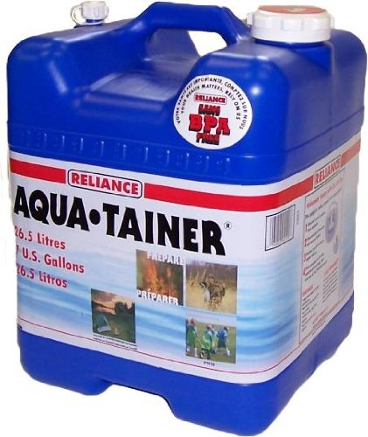
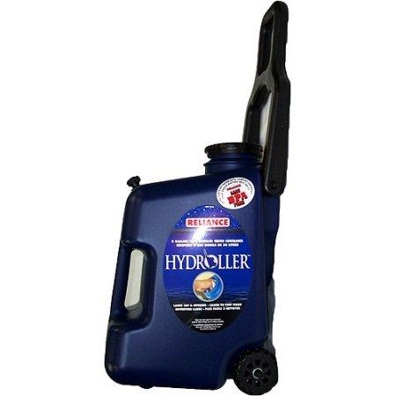
Portable Containers
7 gallon carrier, $15 is the best price point, 7 days of water storage for one person, 56 pounds. Mobile, stackable, comes with spigot.
8 gallon barrel, $34 is an amazing price point, 8 days of water storage for one person, 64 pounds. Mobile, rollable, spigot, handle is needed.

Slide 19
How should I prepare the containers? Before filling with safe water: RC/CDC
Sanitize the container with dish soap and water and rinse completely with clean water.
Disinfect the container by adding a solution made by mixing 1 teaspoon unscented, REGULAR (not splashless) 8.25% household bleach in one quart of water (or 1 T bleach to 1 gallon).
Bleach must be less than 4 months old since it loses 10% of its strength in that time (per Clorox company).
Cover and shake the container so that the solution touches all inside surfaces.
Pour the sanitizing solution out of the container.
Let the empty, disinfected container air-dry OR rinse the empty container with clean, safe water.

Slide 20
Let’s talk BPA since it always comes up.
A researcher in the 1891 synthesized bisphenol A
By the 1930’s, it was used as artificial estrogen
By the 1950’s, used as polycarbonate (strong, often transparent products that resist falling apart when heated or cooled)
Keeps cans from corrosion, so 75% of our food cans have BPA lining.
Hasn't been a food-borne illness in North American cans in 37 years.
Because BPA acts like estrogen, a body hormone, research began:
The manufacturing industry, mostly plastics, research showed there was no or very minimal effect on humans.
The scientific community did their research a completely different way and got very different results.
BPA disrupts puberty, ovulation, infertility, impotence, erectile dysfunction, heart disease, angina, obesity, diabetes, fetal development, breast and prostate cancer, asthma. The CDC reports that BPA is found in nearly all of human urine. (medicalnewstoday.com, 25May2017)

Slide 21
Nowadays, BPA is everywhere: movie tickets, labels, airline tickets and grocery receipts (any thermal or carbonless paper), water bottles, baby bottles, dental fillings/sealants, DVDs/CDs, sports equipment, household electronics, medical devices, eyeglass lenses.
Plastic dinnerware is by far the most pervasive BPA bearer.
BPA is not absorbed through the skin; it is taken from the fingers/hands into the mouth or from liquids/foods in the container into the gut.
So when that plastic is hit with hot water (in our cars, in the dishwasher, in the microwave) or acidic chemicals, the BPA gets free and into us.
There are BPA-free alternatives, but the replacements—BPS and BPF—are just as bad, and even worse, than BPA.

Slide 22
Never fear! There are things you can do:
Buy BPA free canned goods from these companies:
Muir Glen, Amy’s, Wild Planet, Eden Foods, Westbrae Naturals, Native Forest.
Don’t use plastic ware—use glassware whenever possible
Use glass or steel for water bottles
Don’t wash plastics in high-temperature dishwasher
Avoid microwaving food in plastic
Choose wooden toys instead of plastic
Avoid handling receipts, tickets, and labels

Slide 23
How should I prepare the water?
If the tap water has been commercially treated from a water utility with chlorine, you do not need to add anything else to the water to keep it clean. FEMA/ProvidentLiving.org/RC
Fill the bottle to the top with regular tap water or leave 2-3” of room for freezing.
If your home filter takes out the chlorine or your water comes from a well, use the following chart from the Clorox company to treat water and protect you against any lingering organisms in storage containers that weren’t properly cleaned.

Slide 24
Non-chlorinated water (most municipal water is already chlorinated) should be treated with unscented REGULAR (not splashless) liquid bleach with sodium hypochlorite CDC.
Bleach should be less than 4 months old since it loses 10% of its strength in that time.
Tightly close the container using original cap. Be careful not to contaminate the cap by touching the inside with fingers. Place a date on the outside of the container. FEMA/RC
Water | 5-6% Bleach, Clear Water | 5-6% Bleach, Cloudy Water | 8.25% Bleach, Clear Water | 8.25% Bleach, Cloudy Water
1 quart | 2 drops | 4 drops | 2 drops | 4 drops
1 gallon | 8 drops | 16 drops | 6 drops | 12 drops
2 gallons | 16 drops | 32 drops | 12 drops | 24 drops
5 gallons | 40 drops | 80 drops | 30 drops | 60 drops
55 gallons | 4.5 tsp | 9 tsp | 3.5 tsp | 7 tsp
16 drops = 1/4 tsp, 32 drops = 1/2 tsp, 64 drops = 1 tsp

Slide 25
What kind of Hose do I need?
Potable hoses
Regular hoses unless you don’t like the findings from the study below:
The Ecology Center cut 32 hoses, checking their layers for chemicals (ecocenter.org):
22% of the hoses had 100 ppm of lead.
38% of the hoses had 1000 ppm of bromine (fire retardant) in their lining.
75% of the PVC hoses had phthalates, the chemical that makes hoses flexible.
Hoses labeled “drinking water safe” had no lead, bromine and antimony, but did have phthalates.

Slide 26
The Ecology Center filled 7 hoses with water outside for 48 hours and tested the water for chemicals.
3 samples had lead at 13, 19 and 20 ppbillion.
Lead was NOT detected in the hose labeled “drinking water safe.”
1 sample contained BPA at 87 ppb.
None contained detectable phthalates (the “flexible” chemical).
The study mentions lead in the brass fittings at both ends of the hose no matter what kind of hose (PVC or rubber).

Slide 27
Hoses to pick:
Hoses labeled “drinking water safe:” Many of these “lead-free”, “BPA-free” and “phthalate-free.” Two great choices are the lightweight Water Right hose or the more traditional Camco hose. For a lightweight, transparent hose that allows UV rays to kill bacteria in the hose, try the ClearFlow.
Rubber hoses: Natural rubber hoses don’t need phthalates, BPA or UV stabilizers to keep them flexible. The Craftsman Premium Rubber hose earned the “Low Hazard” rating in the Ecology Center’s tests, though it is not rated “drinking water safe.” This one is good for gardening and washing up only.
Store your hoses in a cool, dark place.
Let your hose run before using it.

Slide 28
Where do I store the water? Coldest, darkest, driest, oxygenless, flood and earthquake proof.
Store in the cool and dark. FEMA/RC
Bottled water should be kept out of direct sunlight EPA/ProvidentLiving.org. To increase the shelf life of translucent containers, group the containers together in dark, plastic bags.
Bottled water should also be kept away from toxic chemicals, such as cleaning agents, solvents EPA and gasoline, kerosene, pesticides, or similar substances.

Slide 29
If you have freezer space, store some water in the freezer. Leave 2-3 inches of space when filling containers because water expands as it freezes. Frozen bottles of water:
improve the efficiency of a half empty freezer.
protect the food from thawing in the event of a power outage.
Do not store water containers directly on concrete ProvidentLiving.org since concrete can wick moisture to stored containers very easily USU Extension. A piece of untreated wood, rug/carpet or doubled-over cardboard will be satisfactory.
Do not place your water barrels on treated lumber as they may leach treatment from the wood. Use a strong untreated wooden piece or plastic pallets. Preparedness.ldswelfare.org

Slide 30
The floor should be level to prevent the containers from tipping over and smooth to prevent poking holes in the bottom of the containers.
Store water where potential leakage wouldn’t damage your home. ProvidentLiving.org
Last resort is outside, covered with dark tarp (or barrel bag $20), on a solid, smooth surface, with space given for freezing. It’s better than no water storage at all.

Slide 31
How long can I store water?
The FDA has not established a shelf life for bottled water EPA but should be indefinite RC if kept in the proper environment (dark, cold, etc.) EPA and depending on original water quality.
Rotation serves as an additional precaution against bacteria or viruses growing in containers that may not have been properly cleaned and disinfected.
Stored tap water should be rotated every 6 months. RC
Prepackaged bottled water should be rotated by date on bottle.
Self serve bottled water should be rotated once a year, as long as the water treatment process includes ozonation. RC

Slide 32
Where can I find Water Inside the Home?
If you know your water will go out: CaptainDaves.com
Put 2-3 heavy-duty plastic trash bags (without post-consumer recycled content) inside each other. Then fill inside w/water. You can use a trash can to give structure to the bags.
Fill large, clean containers and cover so you can use the water for drinking and cooking.
Tubs hold @ 65 gallons. Fill your cleaned tub almost to the top. While you probably won't want to drink this water, it can be used to flush toilets, wash hands, dishes, clothes, etc.
WaterBob (10 ml LLDPE 100 gallons, 16 weeks, 1 for $30) or the Aquapod kit (4 ml LLDPE 65 gallons, 8 weeks, 1/$25 or 3/$40), The Reservoir $23, all with siphons.

Slide 33
After a disaster, close the water valve to the outside of your home ASAP. This will:
Prevent contaminated water from entering your house.
Prevent good water from running out as pressure to the entire system drops.
If your tap water is safe to drink (per authorities), so is the water in pipes and water tank. CDC
Access water remaining in pipes Epiccenter.com after closing the valve to the outside of home.
Open a faucet on highest floor to let air into the system = no vacuum created. CDC
Open a faucet at the lowest level with a clean container or hose under it.
Repeat this for both hot and cold systems. CaptainDaves.com
Never drink from radiators or waterbeds CDC since they have algaecide; double size waterbed holds 200 gal for hygiene and sanitation only.

Slide 34
Water drained from an upright hot water tank. A typical water heater holds 30-60 gallons of water. A yearly draining of the tank avoids settled particles.
Turn off the gas/electric supply to tank to prevent heater from operating without water.
Let water heater cool before draining so it does not scald you. NationalTerrorAlert.com
Open the drain at the bottom of the tank.
Place clean containers under drain. RC
Close the water intake valve into the tank by closing the faucet at the top of the tank.
You may need to turn on a hot water faucet elsewhere to alleviate vacuum.
Allow sediment to settle or discard the first few gallons if they contain rust or sediment CO Extension or just boil and use it for hygiene purposes.
Reopen the water valve and let the tank fill with water once emergency is over.
Have professional turn on gas/electricity only AFTER the previous step is done.

Slide 35
Water (5 gal) dipped from the flush tank (not bowl) of toilet. RC says no. Everyone else says:
Purify water before using.
Do not use chemically treated "blue" water.
Water from a swimming pool MAY be used for hygiene purposes only. If consumed, this water can cause diarrhea, even permanent kidney damage, from chlorine contact. Epiccenter.com
Being able to use pool or spa water depends on who and what has been in it, if it’s been maintained, what chemicals have been used. Research the best way to maintain your pool so the water could be filtered and disinfected in an emergency. http://www.lowes.com/projects/other-activities/swimming-pool-maintenance/project
“Pool, toilet tank and spa water should be considered your supply of last resort. Pool or spa water should be used only if it is first boiled (disinfecting chlorine bleach is probably not an adequate safeguard by itself). As mentioned earlier, don't forget to strain the water through a piece of clean cloth before treating.” Stanford.edu

Slide 36
Water used to cook food should be retained and used again. CaptainDaves.com
Use water from canned vegetables to cook with.
Use juice from canned fruits to sweeten other foods (oatmeal, pancakes, muffins).
Melt ice cubes from freezer or scrape inside of freezer for the build-up on the sides of your freezer and melt. If electricity is out, use drain at bottom of freezer as ice inside melts.
Use water from washing hands, clothes and dishes to flush toilets/plants. CaptainDaves.com

